Slide 1
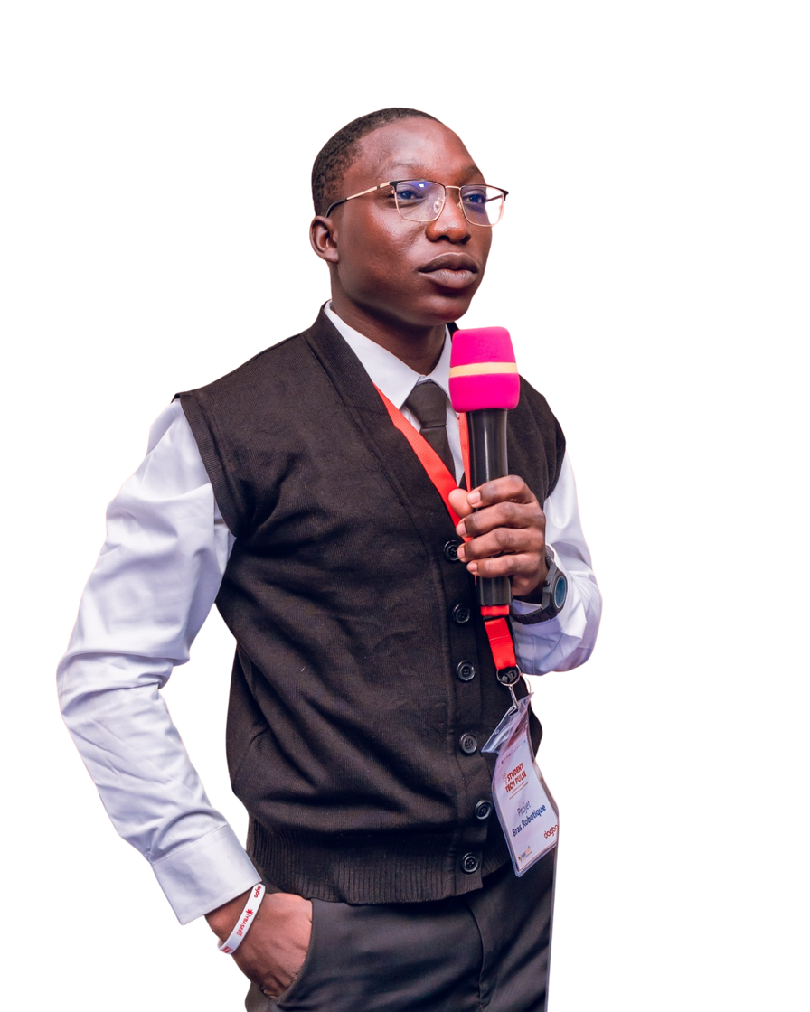

Presentation
PORTFOLIO
PORTFOLIO
AGBALENYO CLEMENT
agbalenyoclementkokou@gmail.com

Slide 2
Presentation
Introduction
About me
TABLE OF CONTENTS
Education
Personal skill
Experience
Project portfolio
First project
Second project
My name is AGBALENYO Kokou Clement. I am a mechanical engineering student currently in my second year. Throughout my academic journey, I have developed a wide range of technical and professional skills, which I am pleased to present through my portfolio.
Contact
Thank you
AGBALENYO CLEMENT
agbalenyoclementkokougmail@.com

Slide 3
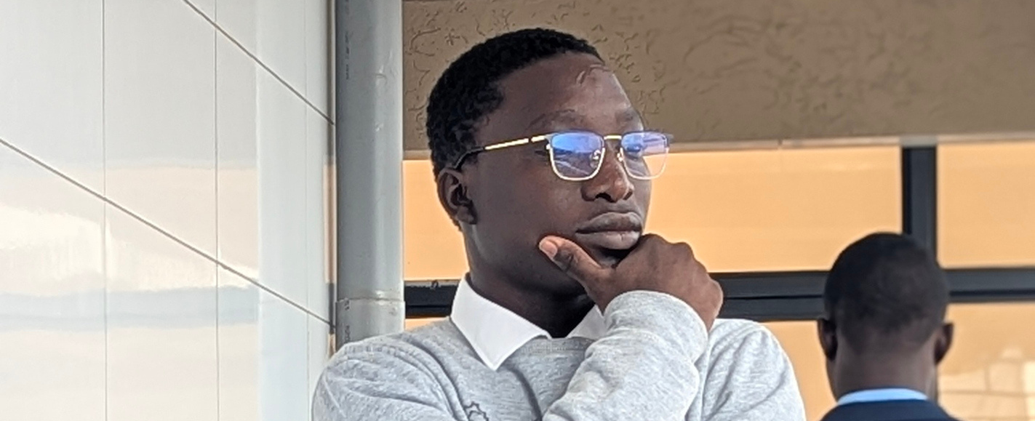
Presentation
INTRODUCTION
AGBALENYO Clement
agbalenyoclementkokougmail.com

Slide 4
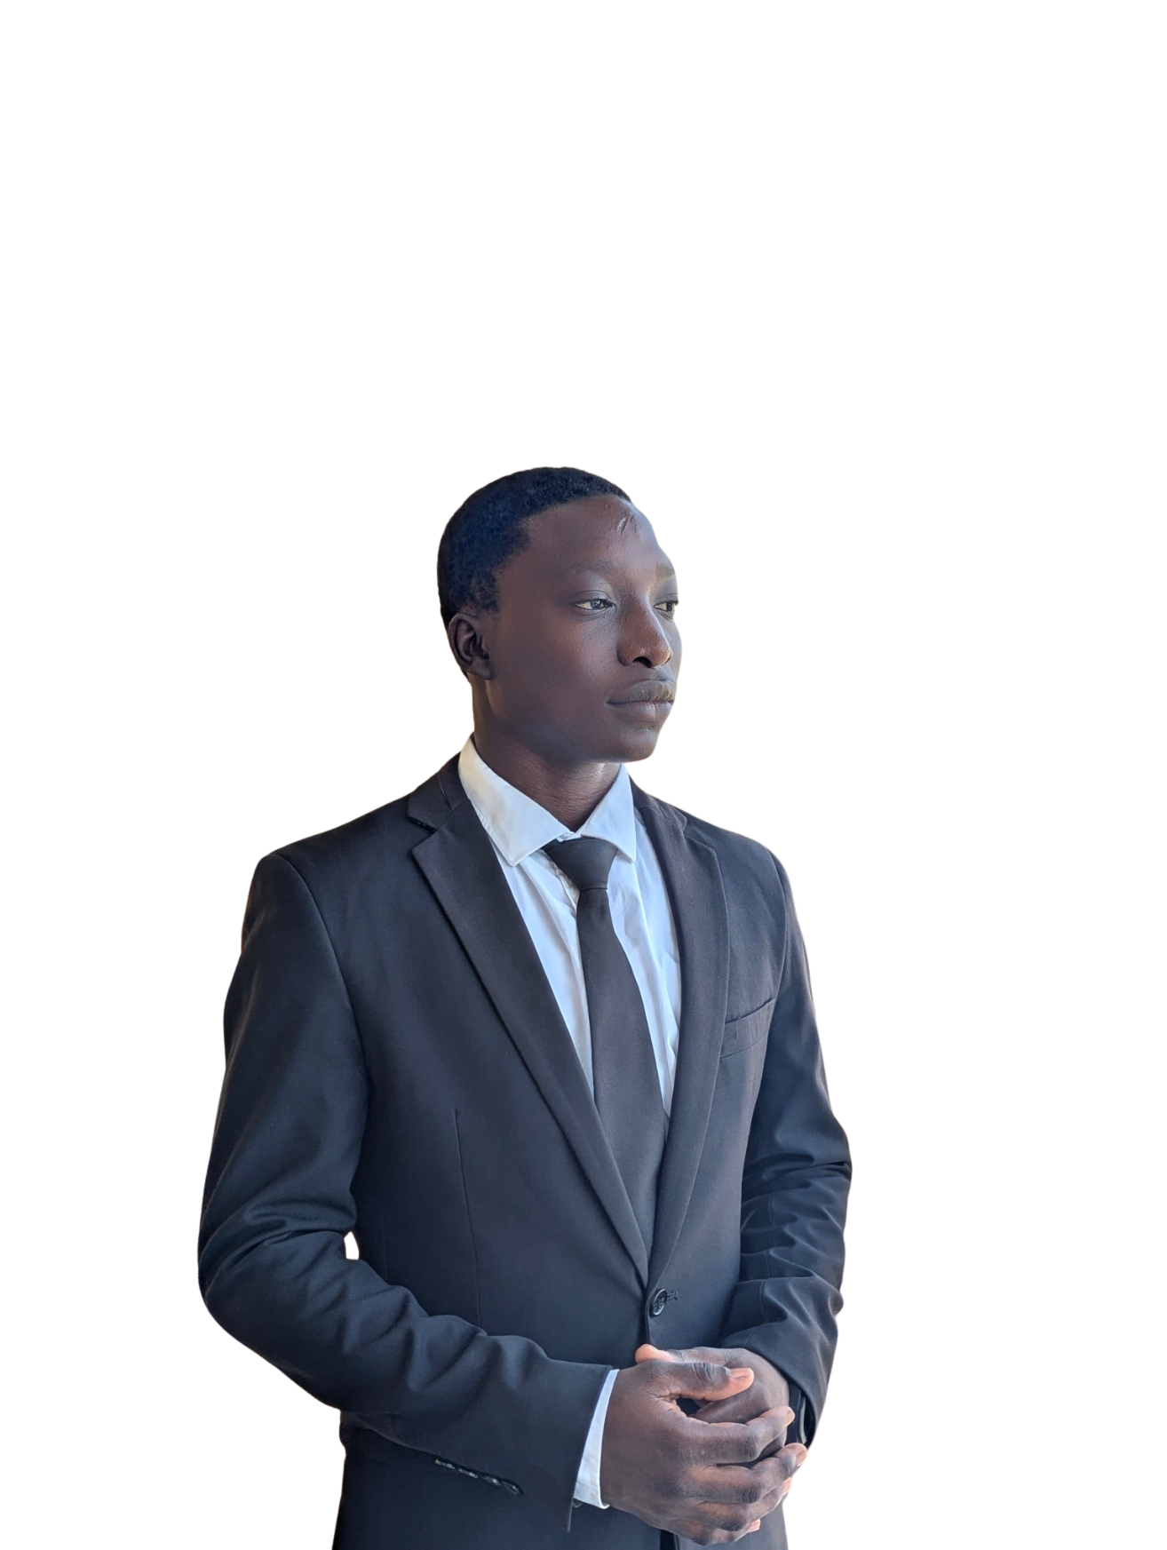
Presentation
AGBALENYO
CLEMENT
I am AGBALENYO Kokou Clement, a mechanical engineering student with a strong interest in design, simulation, and innovative engineering solutions. I am currently in my second year of higher education, where I have built solid foundations in mechanical engineering and applied technologies.
I am passionate about transforming ideas into functional, efficient, and optimized mechanical systems. My work combines technical precision, creativity, and problem-solving, with a constant focus on real-world applications.
AGBALENYO CLEMENT

Slide 5
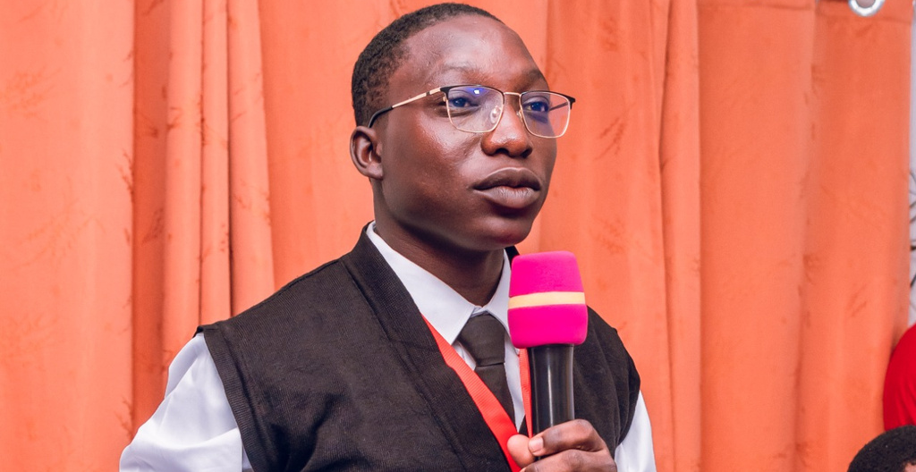
Presentation
EDUCATION
2024
2025
2026
ESIG GLOBAL SUCCESS
ESIG GLOBAL SUCCESS
ESIG GLOBAL SUCCESS
Introduction to the fundamental principles of mechanical engineering, including:
Engineering mathematics and applied physics
Statics and basic mechanics
Technical drawing and engineering graphics
Introduction to materials science
Basics of manufacturing processes
This semester focused on building analytical thinking and understanding core mechanical concepts.
Development of applied engineering skills, with emphasis on:
Mechanical design and CAD (SolidWorks)
Strength of materials
Kinematics and dynamics of mechanisms
Introduction to system modeling
Engineering problem-solving methods
This semester strengthened my ability to design and analyze mechanical components.
Advanced application of engineering concepts through:
Finite Element Analysis (FEA) fundamentals
Simulation using Abaqus and ANSYS
Mechanical system optimization
Introduction to mechatronics
Project-based engineering work
This semester focused on validation, optimization, and real-world engineering applications.
AGBALENYO CLEMENT
agbalenyoclementkokou@gmail.com

Slide 6
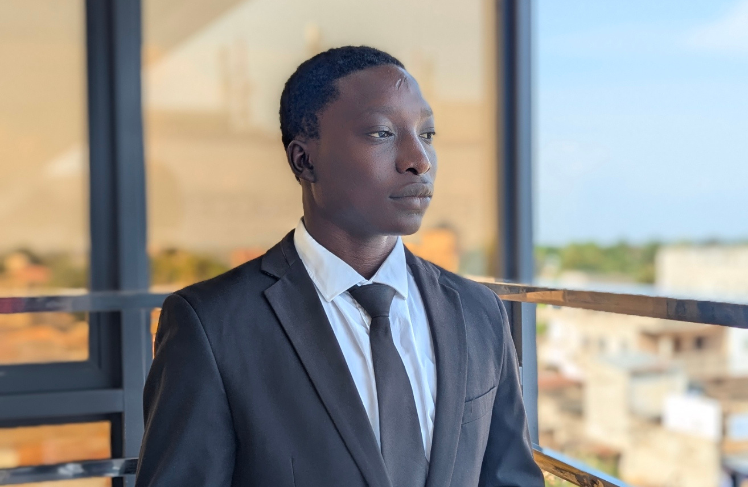
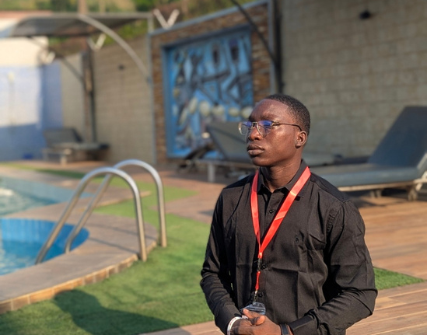
Presentation
PERSONAL SKILLS
Instructor
Passionate trainer with experience in knowledge sharing and skill development. Able to explain complex concepts in a clear, structured, and accessible way, while guiding learners through practical and hands-on learning approaches.
Beatmaking
Creative beatmaker with a strong sense of rhythm, melody, and sound design. Experienced in producing instrumental tracks by combining technical precision with artistic expression, and capable of adapting to different musical styles and creative projects.
AGBALENYO CLEMENT
agbalenyoclementkokou@gmail.com

Slide 7
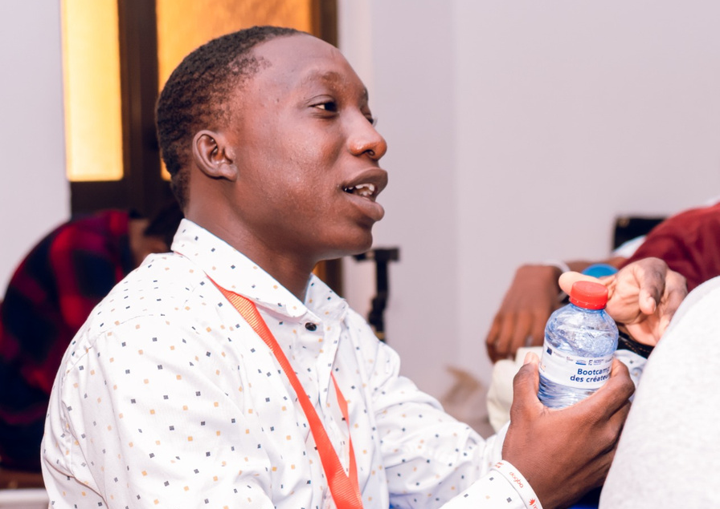
Presentation
WORK EXPERIENCE
2025
2025
Project Manager
Founder - Nova Luz (Music label)
2026
Led multiple school engineering projects, coordinating teams, managing timelines, and delivering technical solutions.Designed and delivered a custom massage vest, from concept to functional prototype, in a professional client-oriented context.
Founded and managed an independent music label, overseeing creative projects and team coordination.
CEO Company “Nesso”
Leading an innovation-driven company focused on engineering solutions, including the development of an intelligent robotic arm project.
AGBALENYO Clement
agbalenyoclementkokou@gmail.com

Slide 8
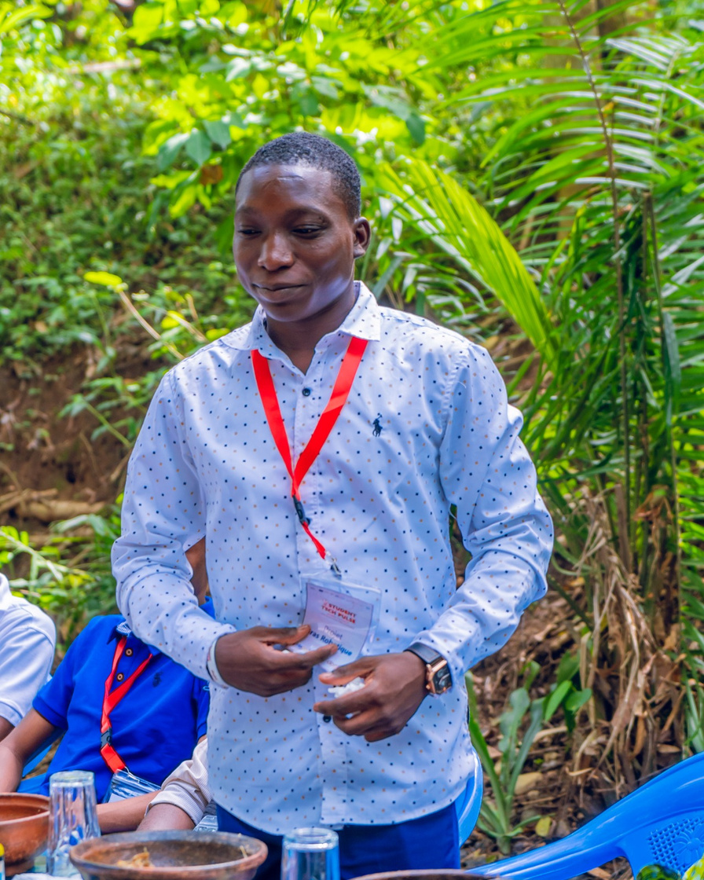
Creative Presentation
PROJECT
portfolio
AGBALENYO Clement

Slide 9
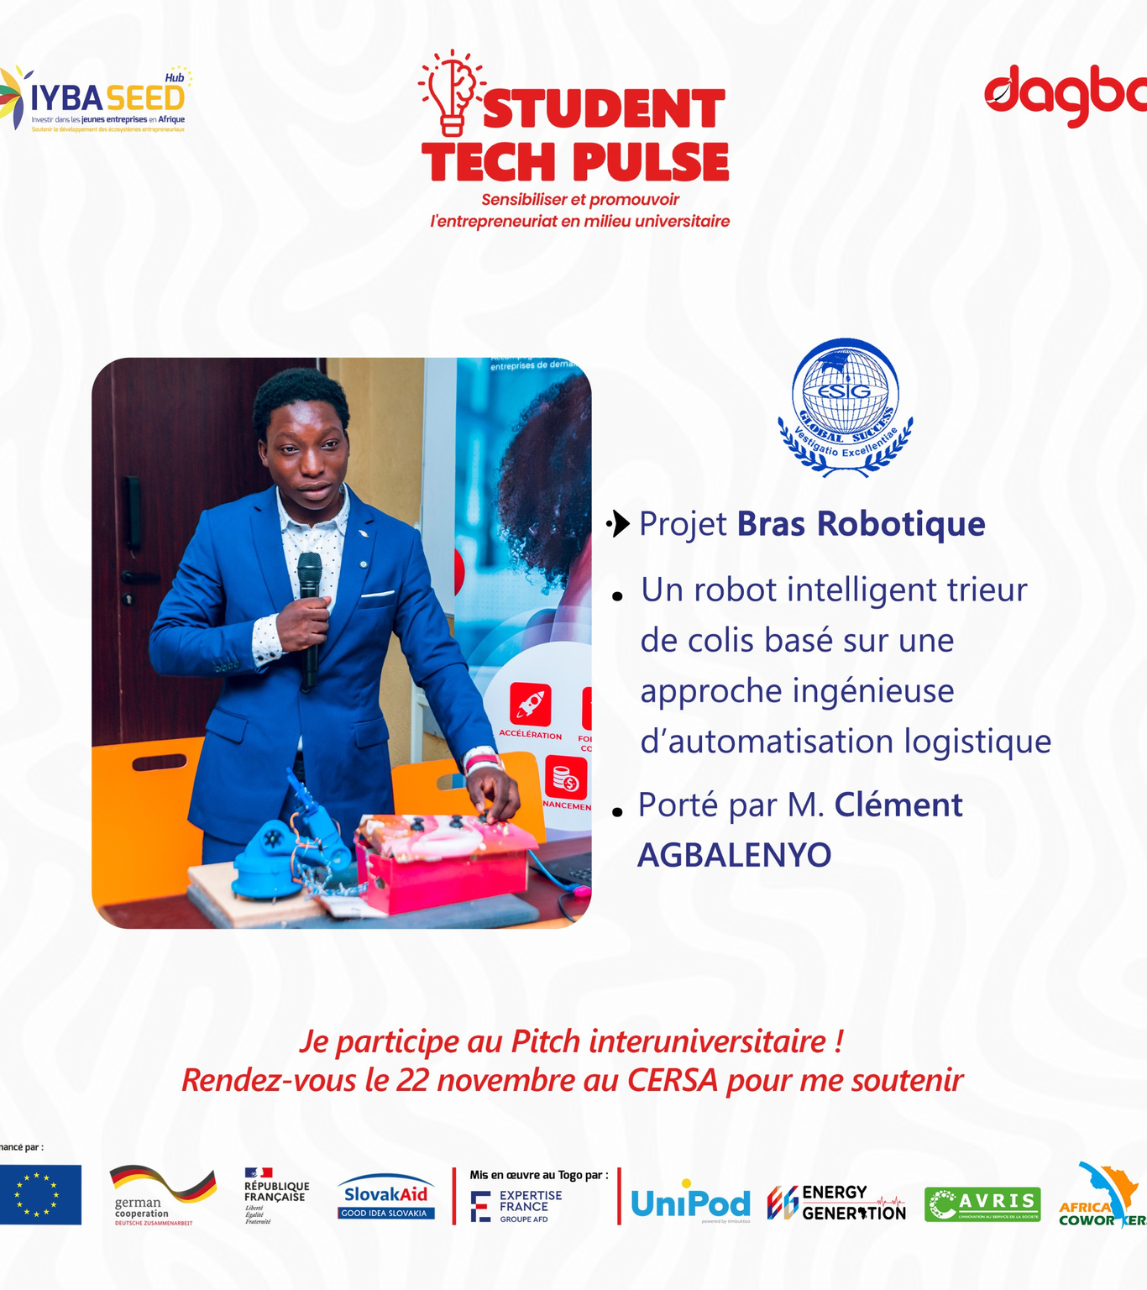
Presentation
FIRST PROJECT
Design and development of an intelligent robotic arm aimed at automating handling and manipulation tasks. This project combines mechanical engineering, mechatronics, and control systems to create a modular, precise, and scalable robotic solution.
The project covers the complete engineering cycle, from mechanical design and system architecture to control logic and functional validation. Particular attention is given to precision, reliability, and adaptability for educational and industrial applications.
AGBALENYO Clement

Slide 10

Presentation
SECOND PROJECT
Black Hole (Blender) – 3D modeling and rendering project exploring realistic lighting, distortion, and cinematic space effects.
AGBALENYO Clement
agbalenyoclementkokou@gmai.com

Slide 11

Presentation
THIRD PROJECT
Founder and creative lead of Noval Luz, producing music and managing artistic projects.
AGBALENYO Clement
agbalenyoclementkokou@gmai.com

Slide 12
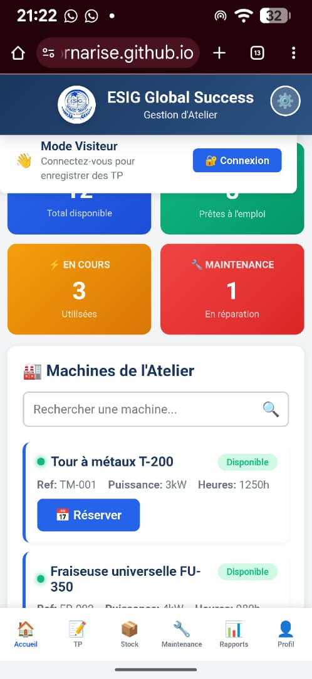
Presentation
FOURTH PROJECT
Created an application to streamline project and tool management in the ESIG school workshop.
AGBALENYO Clement
agbalenyoclementkokou@gmai.com

Slide 13

Presentation
BEST PROJECT
Founder and CEO of NESSO, an innovation-driven engineering company focused on developing advanced technological solutions. The company’s flagship project is the intelligent robotic arm, which demonstrates cutting-edge integration of mechanical design, mechatronics, automation, and control systems.
This project represents the culmination of my technical expertise, leadership, and entrepreneurial vision, combining practical engineering, prototyping, and innovation to create a real-world, scalable solution.
AGBAELENYO Clement
agbaelenyoclementkokou@gmail.com

Slide 14



More Information

Slide 15
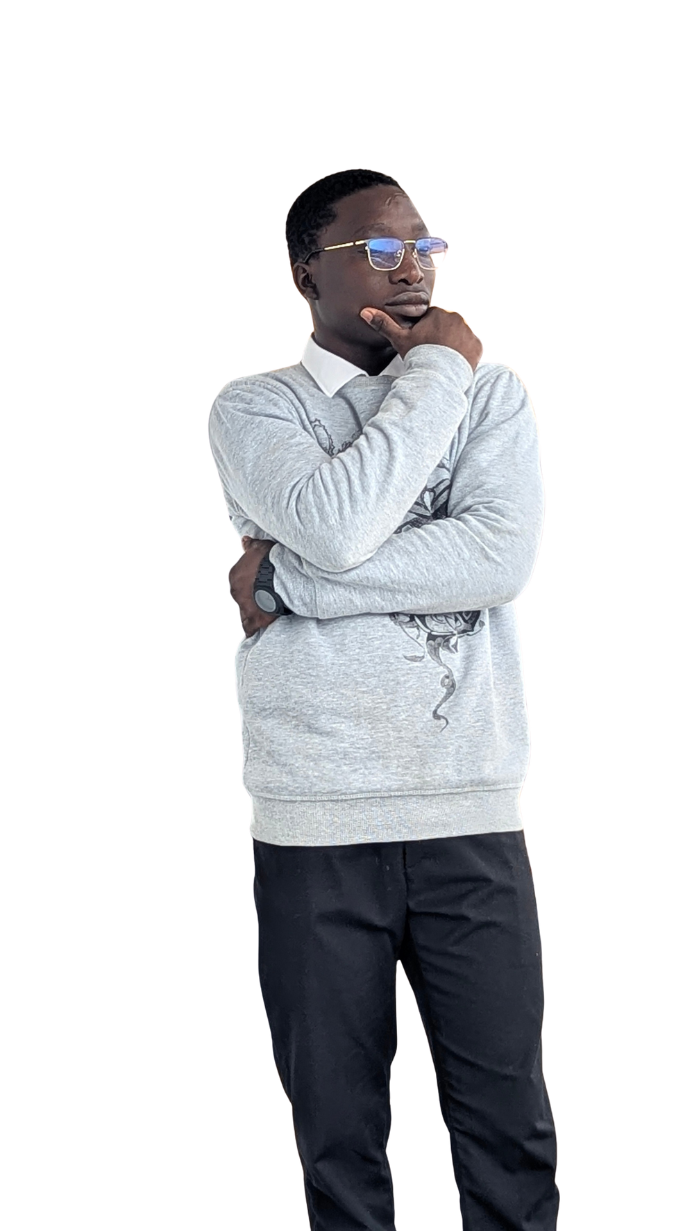
Presentation
THANK YOU
THANK YOU
AGBALENYO Clement
agbalenyoclementkokou@gmail.com

